Slide 1
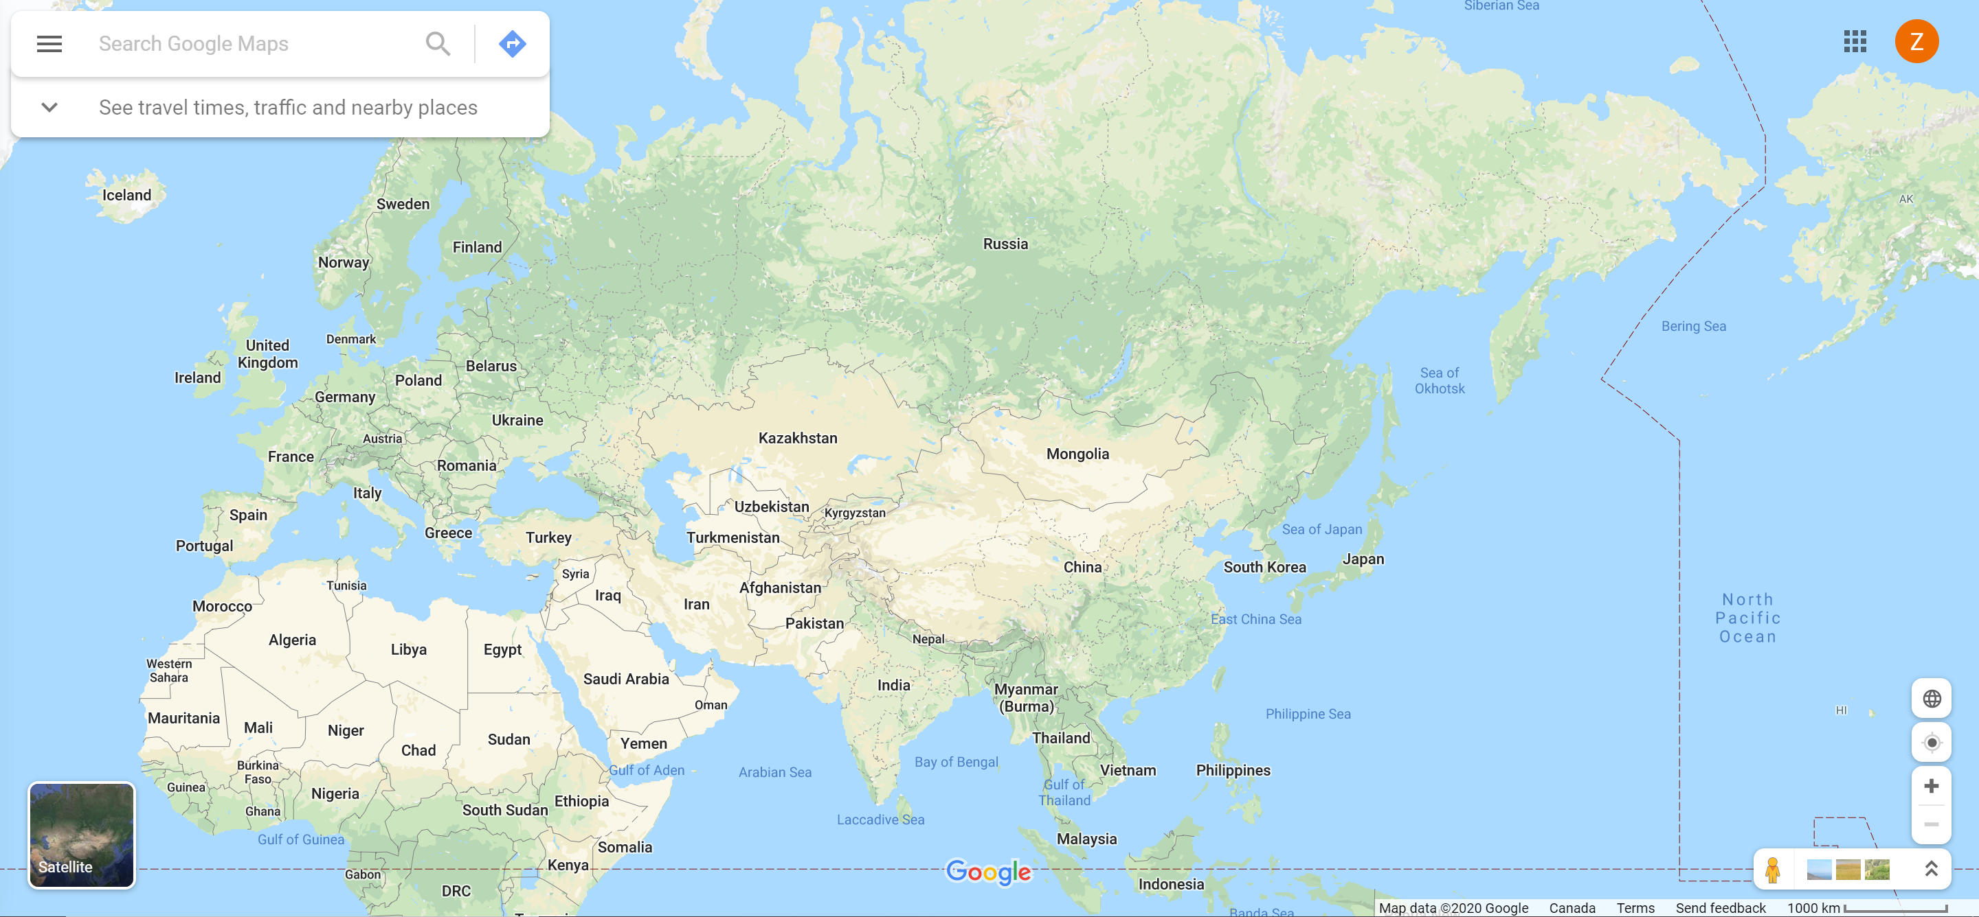
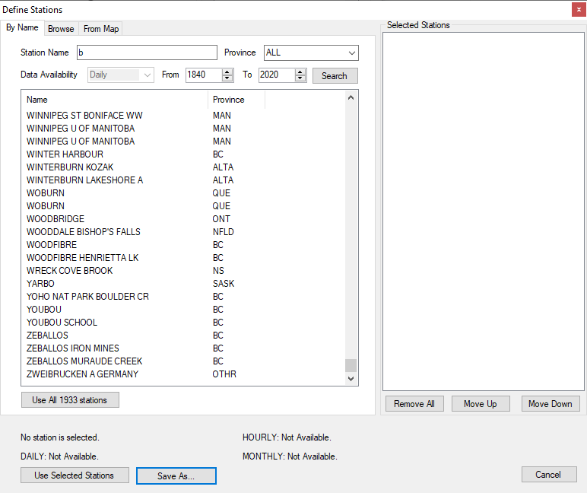
Logo
Search by station name, country name, province name
Upload
Draw
Sign in
Station Name
If Environment Canada, set this to Canada; if NOAA, set this to the US; if global data source, allow user to input
Country Name
Province Name
8
City Name
1990
to
Availability
ALL
2000
Data Source
Environment Canada
Search
6
2
5
Notes:
Where are we putting the future support for models?
Can we support for search by address?
I presume the Search button will find the stations and zoom to the extent.

Slide 2
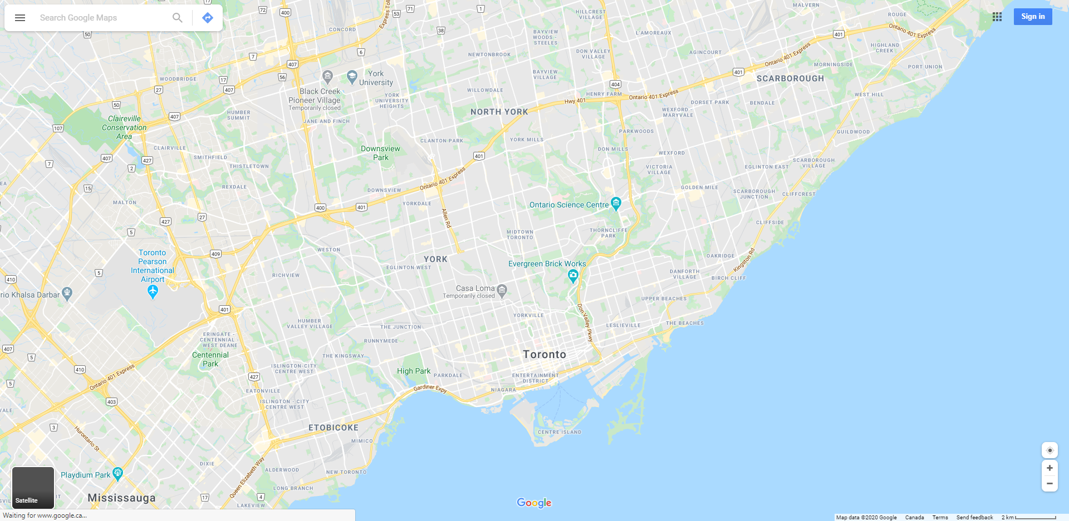


Logo
Upload
Draw
Zoom to polygon extent. All three are related to boundary
Sign in
Toronto
Zoom
Stations
Download
Hourly
rainfall
Show all stations
Name
Toronto 1
Toronto 2
Toronto 3
Toronto 4
Toronto 5
Toronto 6
Hourly, daily, monthly
Wind, solar radiation, humidity
Toggle display of unselected stations
Update station icons based on selection
2
Add to list
Toronto 1
boundary
Elevation: 100 m
All available stations from EC or other sources
Hourly : Not available
Daily : 2008 to 2020
If not login, prompt to login
Monthly : 2008 to 2020
Save both boundary and results to a list. Need login
Legend
Save List
2
Not selected
Use different icon for the one with gaps
5
Selected without gap
The checked render items (top left) will be plotted, e.g. hourly rainfall
Selected with gap
Chart
Statistics (min, max, total, average, etc.)

Slide 3
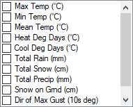
Logo
Toronto
Upload
Draw
Sign in
Stations
Download
Interval
Hourly
Range
1) Keep; 2) Fill with nearby stations with user defined search range and # of stations
Gap
Keep
2
Model
SWAT
Toronto 1
Format
dbf
boundary
Elevation: 100 m
Values
Hourly : Not available
Daily : 2008 to 2020, has gap
Monthly : 2008 to 2020, has gap
2
Emails:
**@gmail.com
Use different icon for the one with gaps
5
Start Download
If not login, prompt to login
Save as Preference
Chart
Statistics (min, max, total, etc.)
Notes:
Are we downloading data station by station or all stations in the list?
For download we may have three options:
Send a FTP link (or DropBox, Google) to download (good for sharing with others)
Send an email with data in attachment (if file is not too large)
Download to local computer (good for own use)

Slide 4
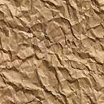
Logo
Toronto
Upload
Draw
Michael Yu
Stations
Download
My profile
After signing
My list
Interval
Hourly
My downloads
Range
Download preference
Gap
Keep
2
Sign out
Model
SWAT
Format
dbf
Values
2
Emails:
**@gmail.com
5
Start Download
Save as Preference
Chart
Statistics (min, max, total, etc.)

Slide 5
Logo
Toronto
Upload
Draw
Michael Yu
Stations
Download
My List
My downloads
Interval
Hourly
Name | # of Stations
List 1 | 10
List 2 | 20
Toronto 3 | 5
Range
open
Gap
Keep
2
Model
SWAT
open
Format
dbf
open
Values
Show all stations on map
2
Emails:
**@gmail.com
5
Start Download
Save as Preference
Chart
Statistics (min, max, total, etc.)

Slide 6

Logo
Toronto
Upload
Draw
Michael Yu
Stations
Download
My List
My downloads
Interval
Hourly
List | Date
List 1 | May 2, 2020
List 2 | May 2, 2020
Unsaved | May 2, 2020
Range
Gap
Keep
2
Model
SWAT
Format
dbf
Values
Download Preference
Pop-up to specify preference including gap, model and format
2
Emails:
**@gmail.com
5
Start Download
Save as Preference
Chart
Statistics (min, max, total, etc.)

